Slide 1
Lung Nodule Analysis
RNS INSTITUTE OF TECHNOLOGY
BENGALURU - 98
DEPARTMENT OF INFORMATION SCIENCE & ENGINEERING
Final Year Project Work Presentation
Apoorva Kashi | 1RN18IS023
Kirtana Sridharan | 1RN18IS061
Mohammed Misran | 1RN18IS067
Nikitha S | 1RN18IS070
Internal Guide
Dr. R Rajkumar
Asso. Prof, Dept of ISE, RNSIT
Panel 1
Mrs. Chandan Rani S R
Asst. Prof, Dept of ISE, RNSIT
Panel 2
Ms. Kavya T C
Asst. Prof, Dept of ISE, RNSIT

Slide 2
AGENDA
Abstract
Introduction
Literature Review
Analysis
System Design
Implementation
Testing
Discussion of Results
National Conference Paper
Conclusion and Future Enhancements
References
Q & A

Slide 3
ABSTRACT
Lung cancer is one of the most threatening diseases among all other lung disorders which is caused for uncontrolled cell growth.
Computed Tomography (CT) scans are generally used for medical imaging due to less noise.
Our project takes three-dimensional CT scans of human torsos as input and produce as output the location of suspected malignant tumors, if any exist.

Slide 4
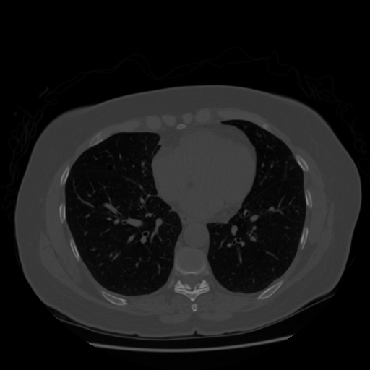
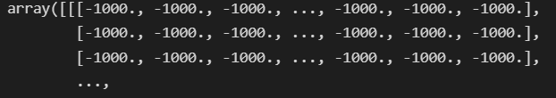
INTRODUCTION
In this project we will break down our problem and solve a series of simpler problems that will combine to provide the end-to-end result.
What is a CT scan?
Bone and dense tissue
Lung nodules

Slide 5
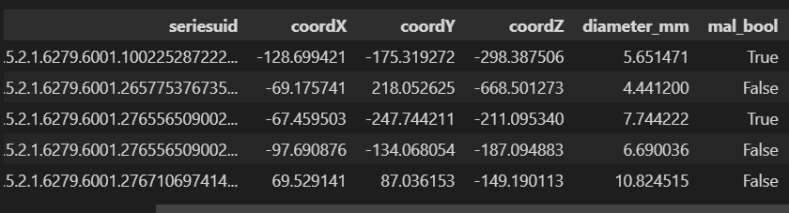
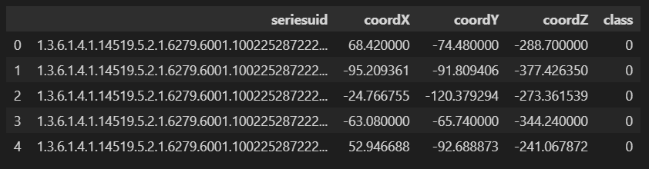
INTRODUCTION
The dataset we have used is from the LUNA (Lung Nodule Analysis) Grand Challenge which contains data for about 900 CT scans, with 1200 nodules as well as human-annotated outputs for classification and grouping.
ANNOTATION DATA:
1200 NODULE DATA
CANDIDATES DATA:
7,50,000 DATA

Slide 6
LITERATURE REVIEW
Sl No | Title of the paper | Techniques Used | Contribution | Limitation | Datasets used | Performance
1. | Lung Cancer Detection using Co-learning from Chest CT Images and Clinical Demographics | Attention-based Convolutional Neural Net, Random Forest Classifier | Efficiently captures anatomical information for classification and also generates attention maps that explain the features that drive performance. | Limited number of training scans, which is relatively small for deep learning | ImageVU, a research resource supported by the VICTR CTSA award | Co-learning model improves the AUC from 0.687 (image-only) and 0.635 (clinical-only) to 0.787
2 | Lung cancer detection system using lung CT image processing. | Haralick features extracted from segmentation. Classification of cancer by artificial neural networks. | Application of median Filter to eliminate impulse noise in the images. GCLM to analyse texture and extract features. | Only 128 training images used. Improper segmentation due to misclassification of ROI are probable. Different segmentation techniques may perform better. | Data collected from a hospital database. | Accuracy of 92%
VIII Semester, Department of ISE, RNSIT
2021 - 2022
6

Slide 7
LITERATURE REVIEW
Sl No | Title of the paper | Techniques Used | Contribution | Limitation | Datasets used | Performance
3. | Evaluate the Malignancy of Pulmonary Nodules Using the 3D Deep Leaky Noisy-or Network, 2017 | 3D region proposal network for nodule detection. Leaky noisy-or gate to obtain the probability of lung cancer, U-Net as backbone. | The over-fitting caused by the shortage of training data is alleviated by training the two modules alternately. | The nodule selection and manual annotations may raise considerable noise.detection module is. It is designed to neglect the very small nodules during training, the LUNA16 evaluation system is not suitable for evaluating its performance. | LUNA and DSB | Accuracies were 73.73% and 69.76% on the training and test sets
VIII Semester, Department of ISE, RNSIT
2021 - 2022
7

Slide 8
LITERATURE REVIEW
Sl No | Title of the paper | Techniques Used | Contribution | Limitation | Data sets used | Performance
4 | 3D Neural Network for lung cancer risk prediction on CT volumes 2020 | Segmentation, Classification using CNN | Application and analysis, without computing the morphology and texture, the architecture of CNN, in classifying the lung nodules as benign or malignant. | 3D CT scans will give better results compared to 2D. | LIDC-IDRI database- collaboration between the LIDC and the IDRI, and 1018 tests of CT are included online. | Accuracy- 97.2%
5 | Malignant Lung Nodule Detection using Deep Learning, 2020 | Deep Convolutional Neural Network (DCNN) | Creation of a model that predicts the coordinates of malignant pulmonary nodules and demarcates the corresponding areas from the CT scans. |  | LIDC-IDRI dataset and resources obtained from the LUNA16 | Sensitivity of Malignant Lung Nodule Detection is 86 %,
VIII Semester, Department of ISE, RNSIT
2021 - 2022
8

Slide 9
LITERATURE REVIEW
Sl No | Title of the paper | Techniques Used | Contribution | Limitation | Data sets used | Performance
6 | Recurrent Residual Convolutional Neural Network based on U-Net | Inflated 3D ConvNet | reproduces a state-of-the-art deep learning algorithm for lung cancer risk prediction. The model predicts malignancy probability and risk bucket classification from lung CT studies |  | (NLST) dataset, LDCT dataset | Accuracy- 89.2%
7 | Lung Cancer Detection Based On CT-Scan Images With Detection Features Using Gray Level Co Occurrence Matrix (GLCM) and Support Vector Machine (SVM) Methods 2020, | segmentation Discriminant analysis, | The segmentation method used in this research is thresholding which aims to divide the histogram of an image with different gray levels into two areas without having to enter a threshold value. | SVM algorithm is not suitable for large data sets | study, the input used is an offline image of a patient's lung CT-scan images. The image used is of type .jpg. | Accuracy- 83.33%.
VIII Semester, Department of ISE, RNSIT
2021 - 2022
9

Slide 10
LITERATURE REVIEW
Sl No | Title of the paper | Techniques Used | Contribution | Limitation | Data sets used | Performance
8 | Automated Detection of Lung Cancer Using CT Scan Images 2020 | Thresholding based Otsu's technique used for segmentation | contrast stretching for image enhancement as it comparatively performs better on the gray scale image a | 3 images used for training | dataset contains 000 T1-weighted contrast-enhanced images from 3 patients. | accuracy rate of 95%
9 | Detection of Lung Cancer in CT Images using Image Processing | median filtering for image pre- processing followed by segmentation of lung region of interest using mathematical morphological operations. SVM algorithm for classification | The size and shape of tumor present in the lungs is estimated by extracting three geometrical features. The features are area, perimeter and eccentricity of cancerous lung nodule. |  | Cancer Imaging Archive database. | extracted features of a sample CT image are Area: 1793 • Eccentricity: 0.7319 • Perimeter: 161.6980
VIII Semester, Department of ISE, RNSIT
2021 - 2022
10

Slide 11
LITERATURE REVIEW
Sl No | Title of the paper | Techniques Used | Contribution | Limitation | Data sets used | Performance
10 | Diagnostic classification of lung nodules using 3D Neural Networks 2018 | Deep neural networks,3D DenseNet, MoDenseNet | four two-pathway Convolutional Neural Networks (CNN) are used, including a basic 3D CNN, a novel multi-output network, a 3D DenseNet, and an augmented 3D DenseNet with multi-outputs aims to learn a direct mapping from 3D images to class labels | 3D CT scans will give better results compared to 2D. | LIDC-IDRI | accuracy rate of 90.40%
VIII Semester, Department of ISE, RNSIT
2021 - 2022
11

Slide 12
ANALYSIS
PROBLEM IDENTIFICATION
The main cause of such high death rate is the detection in the later stages.
Since there are no apparent signs or symptoms of early lung cancer, the clinical diagnosis of lung cancers are often late, making treatment expensive and ineffective.
Currently, the work of reviewing the data must be performed by highly trained specialists which requires painstaking attention to detail, and it is dominated by cases where no cancer exists.
Imaging techniques can help automate this task and make the detection process more efficient.

Slide 13
ANALYSIS
OBJECTIVES
This project aims to develop a lung cancer detection system based on 3D CT-scan images.
The objective of this project is to design an automatic detection and classification system that would identify cancerous tumours accurately which otherwise would be tedious compared to traditional hand-engineered methods.
To build a model for early detection of lung cancer in order to increase survival rates.

Slide 14
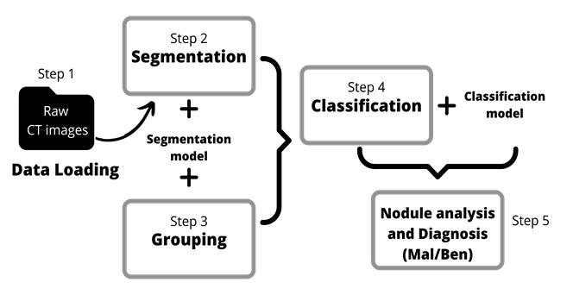
ANALYSIS
METHODOLOGY

Slide 15
ANALYSIS
SYSTEM REQUIREMENT SPECIFICATION
Hardware requirements:
Processor: Intel i5 10th generation or higher/ AMD Ryzen
GPU: CUDA-capable GPU ( NVIDIA GTX 1070 or better)
RAM: 8 GB minimum
Free disk space: 200GB (120GB uncompressed data + 80GB training)
Software requirements:
OS: Windows 10
Language: Python
Front-end: HTML, CSS, JavaScript
Back-end: Flask
Libraries: PyTorch
IDE: Jupyter Notebook, VS Code

Slide 16
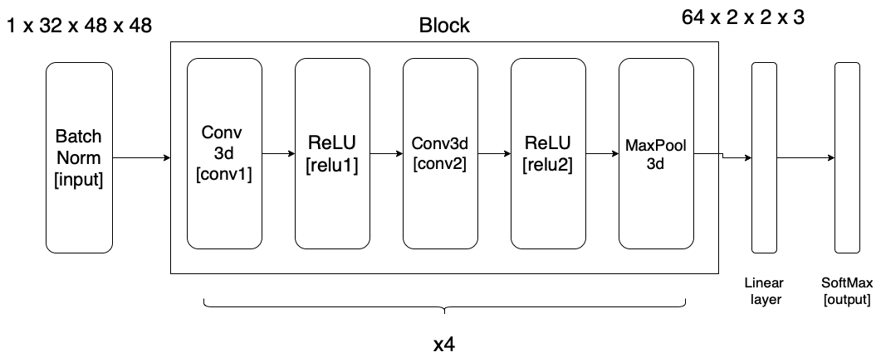


SYSTEM DESIGN
Classification Model Architecture
$n_{out}=\frac{\left(n_{inp}−K+2P\right)}{s}$ + 1
3

Slide 17
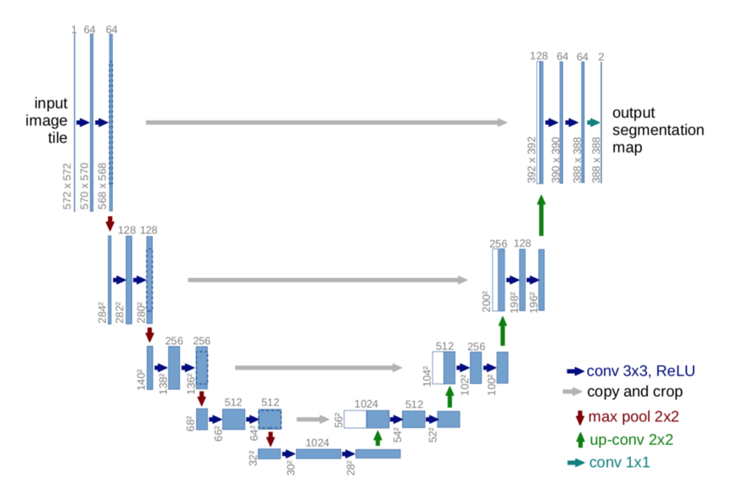
SYSTEM DESIGN
Segmentation Model Architecture
Modifications made to Unet:
Pass the input through batch normalization.
Pass the output through a Sigmoid layer to restrict the output to the range [0, 1].
Reduce the total depth and number of filters we allow our model to use.

Slide 18
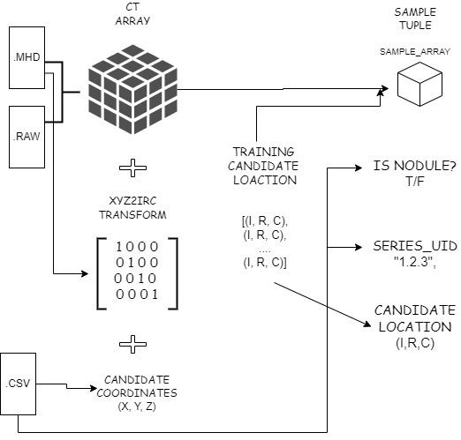
SYSTEM DESIGN
Combining Data
The following operations take place:
.mhd and .raw files form the 3D array of the CT data.
The metadata is combined with annotations and candidates data.
Coordinate conversion from patient to array coordinates.
Conversion of array to tensor.
Sample tuple creation for training.

Slide 19
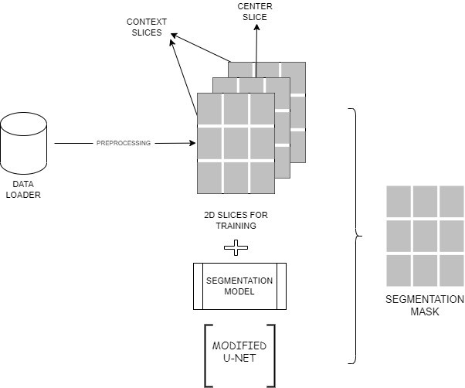
SYSTEM DESIGN
Segmentation
Segmentation process:
The dataloader provides preprocessed data in batches.
The input data is 2D slices of CT with neighbouring slices.
The model used is the Modified Unet segmentation.
Output of the segmentation process is a 3D mask.

Slide 20
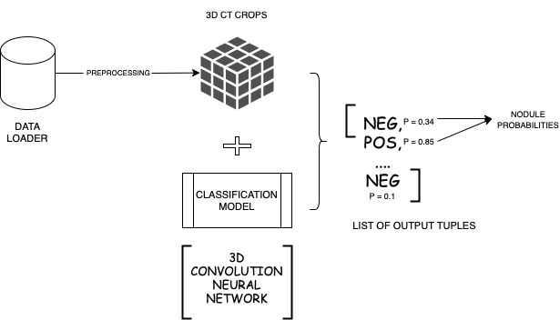
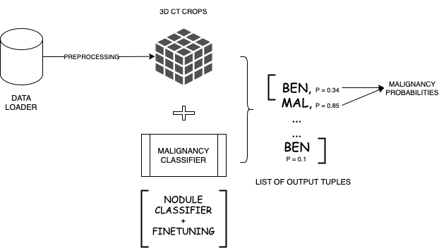
SYSTEM DESIGN
Classification
Nodule-Non-nodule classifier and the Malignancy classifier:
The first classification model predicts the probabilities of positive nodules.
The malignancy classifier predicts malignant and benign nodule probabilities for the nodules that pass through the initial classifier

Slide 21
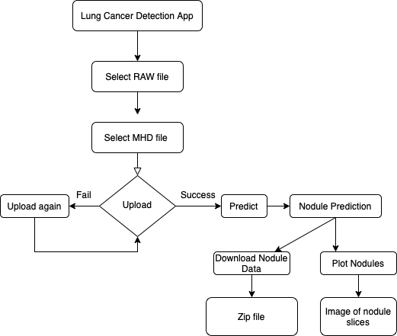
SYSTEM DESIGN
Web Application Data Flow

Slide 22
IMPLEMENTATION
SEGMENTATION
GROUPING
Call segmentation data loader to load the data in batches in seg_dl.
For each input_t, slice_ndx_list in seg_dl:
Load input_t onto the gpu as input_g
Call the trained segmentation model.
For slice_ndx in slice_ndx_list:
Send the predicted values in the form numpy back to the cpu.
Stack 2D output masks in output_a.
Create the mask using a threshold on output.
Return the mask
Group the candidate nodules using label
Using center_of_mass locate the center of each grouped candidate.
Convert the (I, R, C) coordinates to (X, Y, Z)
Return the list of tuples with coordinates

Slide 23
IMPLEMENTATION
CLASSIFICATION
Call segmentation data loader to load the data in batches in cls_dl.
For each _, batch_tup in cls_dl
Unpack batch_tup into input tensors input_t and send it to the gpu as input_g
Call the trained nodule classification model and the malignancy classification model to make predictions.
For each center_irc, prob_nodule, prob_mal in zip_iter:
Return the classification tuple cls_tup consisting of the two probabilities and center coordinates.

Slide 24
IMPLEMENTATION
PREDICTION
Read .raw and .mhd file of the CT scan
Create CT object of the CT class by passing the read file.
Create the segmentation masks.
Create a list of possible candidates using grouping.
Create a list of positive candidates using classification model
Apply a threshold to the classification list and obtain malignancy probability list
Return mal_list

Slide 25
TESTING
Unit testing
Test Case | Description | Expected Output | Actual Output | Result
1 | Get candidates list from candidates.csv and annotations.csv files | Candidates list should be a list of CandidateTuple objects which is a named tuple with the following keys: isNodule, diameter_mm, series_uuid, and center_xyz | Candidates list generated is a list of CandidateTuple objects with the expected keys: isNodule, diamter_mm, series_uuid, and center_xyz | Pass
2 | Check the data types of each key in the named tuple CandidateTuple | isNodule must be a boolean, diameter_mm must be a float, series_uuid is a string, and center_xyz must be a float tuple with length 3 | isNodule is a boolean, diameter_mm is a float, series_uuid is a string, and center_xyz is a tuple of all floats with length 3 | Pass
3 | Load CT scan into a format which is usable by PyTorch | Read the metadata of the scan and convert the RAW image into a numpy array | The CT scan is loaded and converted into a numpy array | Pass
4 | Check the data types of loaded Ct instance | hunits_arr must be a numpy array with shape (*, 512, 512), origin_xyz and voxSize_xyz must be float tuples of length 3, and direction_arr must be a numpy array with shape (3, 3) | hunits_arr is a numpy array with shape (*, 512, 512), origin_xyz and voxSize_xyz are float tuples of length 3, and direction_arr is a numpy array with shape (3, 3) | Pass

Slide 26
TESTING
Integration testing
Test Case | Description | Expected Output | Actual Output | Result
1 | Select RAW and MHD files to the input provided in the client | Should allow files with the extensions .raw and .mhd to be uploaded. | Allows files with the extensions .raw and .mhd. | Pass
2 | Enable the button to upload the server | Once files with allowed extensions are selected to the input, the button to upload them to the server must be enabled. | Files with allowed extensions are selected to the input. The button to upload them to the server is enabled. | Pass
3 | Upload the selected RAW and MHD files to the server | Should allow files with the extension .raw and .mhd. If files with the allowed extensions are provided, the server must decode them and store them in the data directory, and must respond with 200 OK. Otherwise, the server must respond with a 400 BAD REQUEST. | Allows files with the extension .raw and .mhd. Files with the allowed extensions are decoded and stored in the data directory, and then the server responds with a 200 OK. For other files, the server responds with a 400 BAD REQUEST. | Pass
4 | Enable the button to predict results for uploaded CT data | Once the server responds with a 200 OK when the files are uploaded, the predict button must be enabled. | The server responds with a 200 OK when the files are uploaded, and the predict button is enabled. | Pass

Slide 27
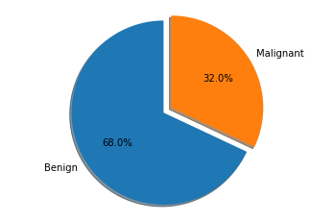
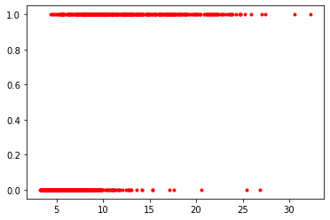
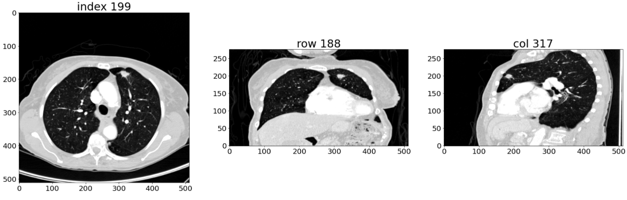
RESULTS AND DISCUSSIONS
Percentage of Malignant and Benign nodules
Diameter plotted against Malignancy
Z, Y, X axes views of the CT scan

Slide 28
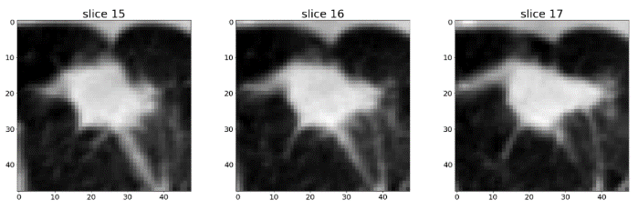
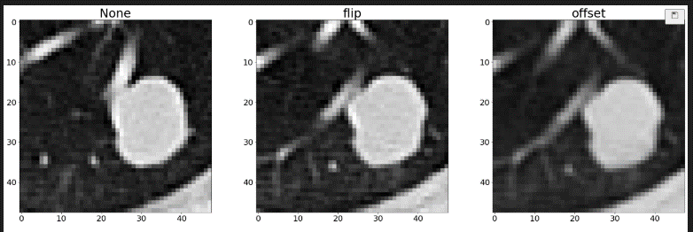
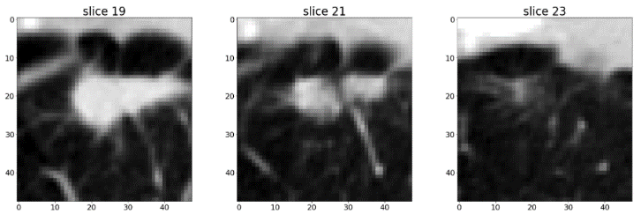
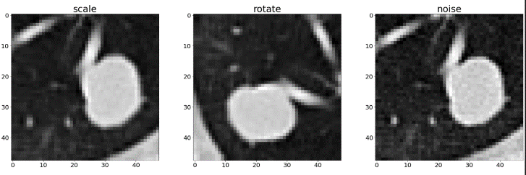
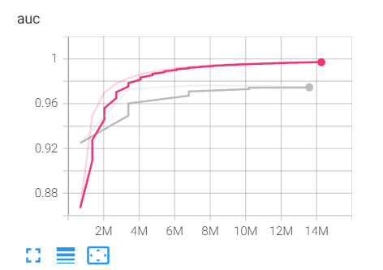
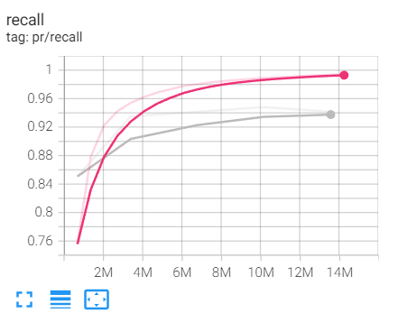
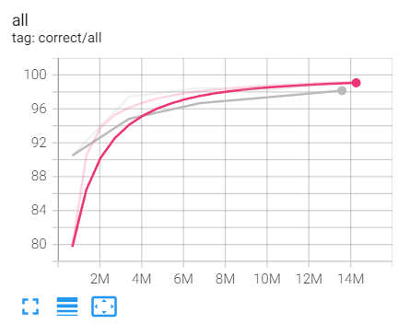
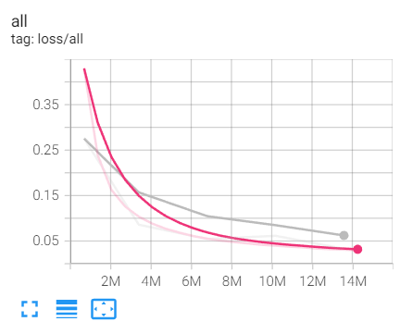
RESULTS AND DISCUSSIONS
Slices from 3D crops for classification
Augmented Data
Classification Metrics: AUC, Recall, Correctness, Loss

Slide 29
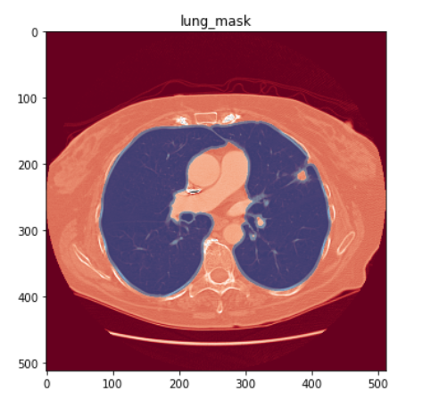
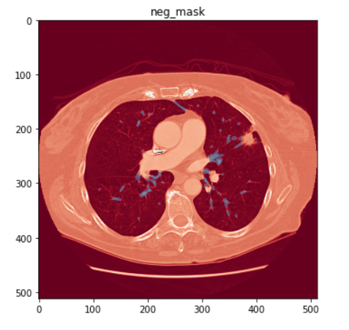
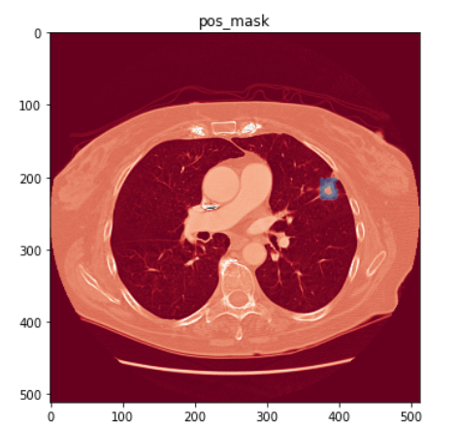
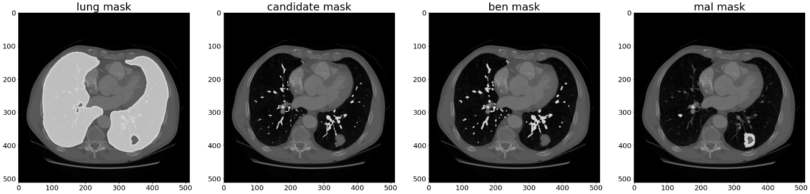
RESULTS AND DISCUSSIONS
Lung mask
Negative mask
Positive mask
Masks: Lung, Candidates, Benign, Malignant

Slide 30
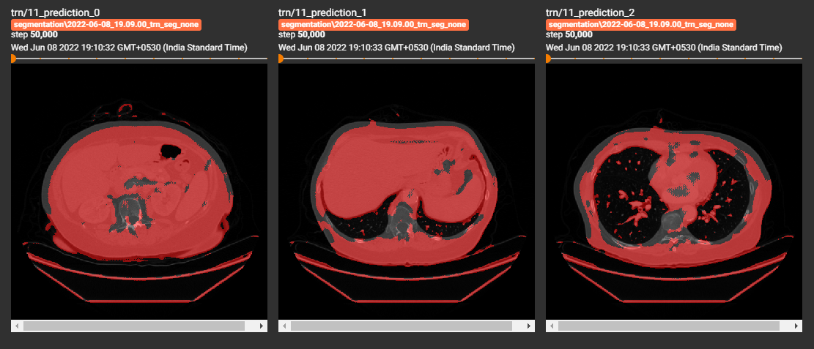
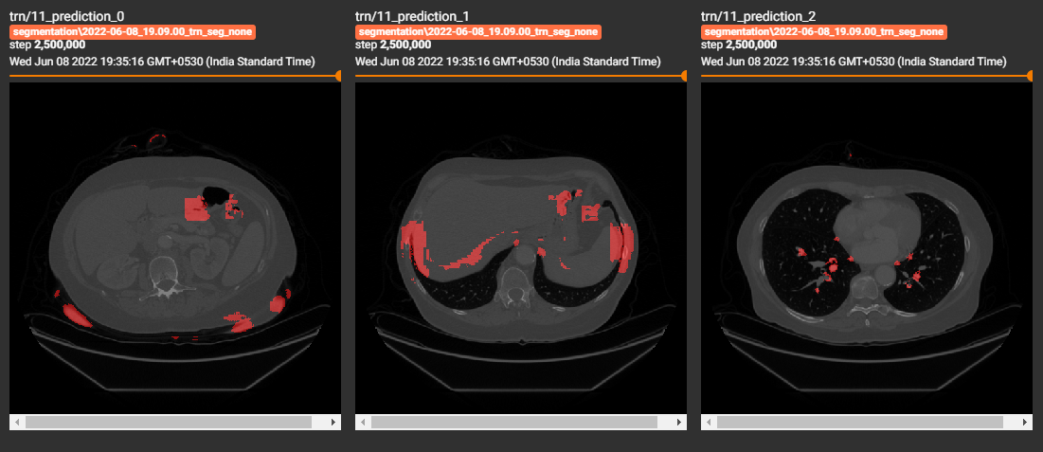
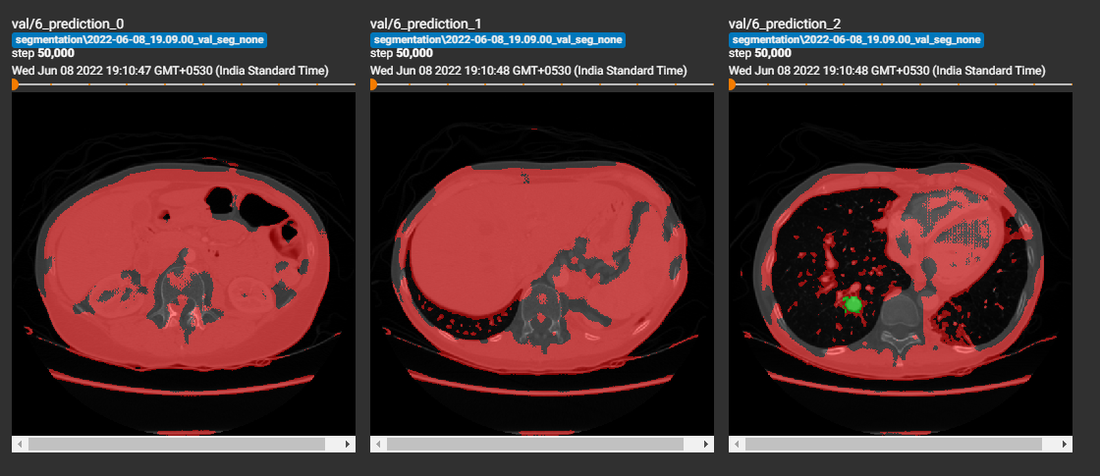
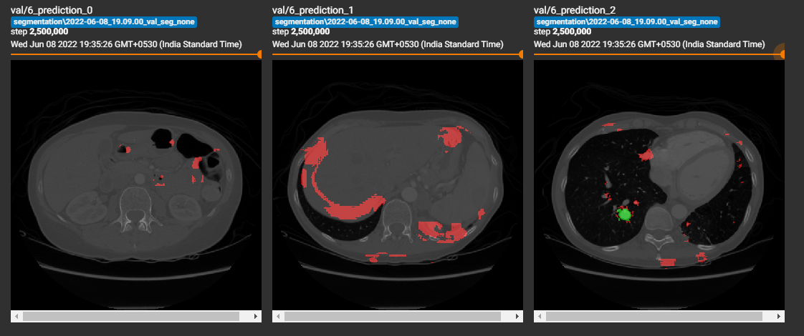
RESULTS AND DISCUSSIONS
MASKS BEFORE AND AFTER TRAINING
Mask on training data before Training
Mask on training data after Training
Mask on validation data before Training
Masks on validation data after Training

Slide 31
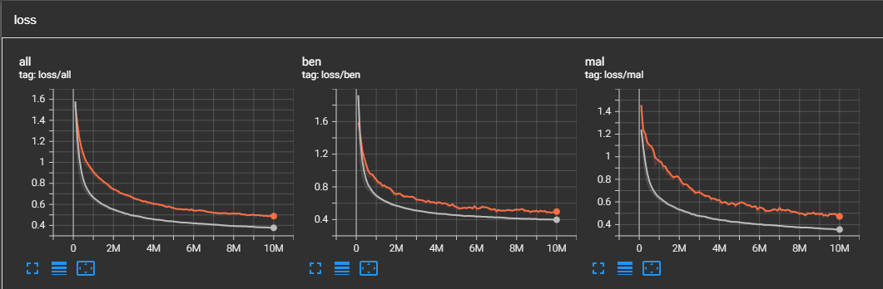
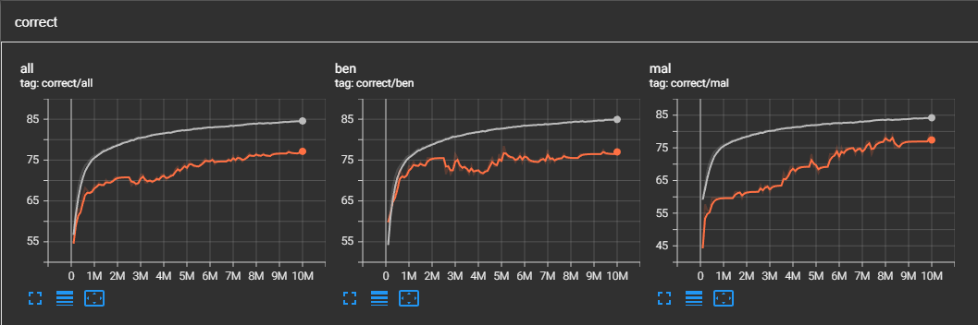
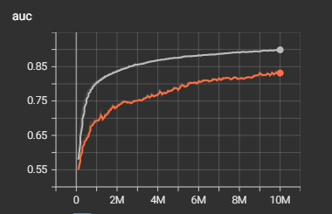
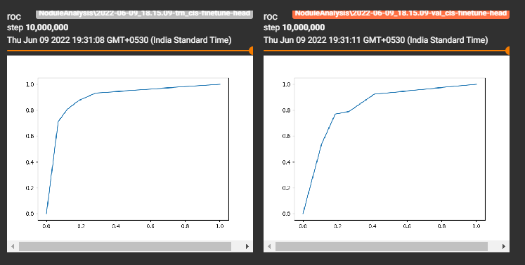
RESULTS AND DISCUSSIONS
MALIGNANCY CLASSIFIER METRICS
Malignancy classifier loss
Malignancy classifier correctness
Auc metrics
Roc metrics

Slide 32
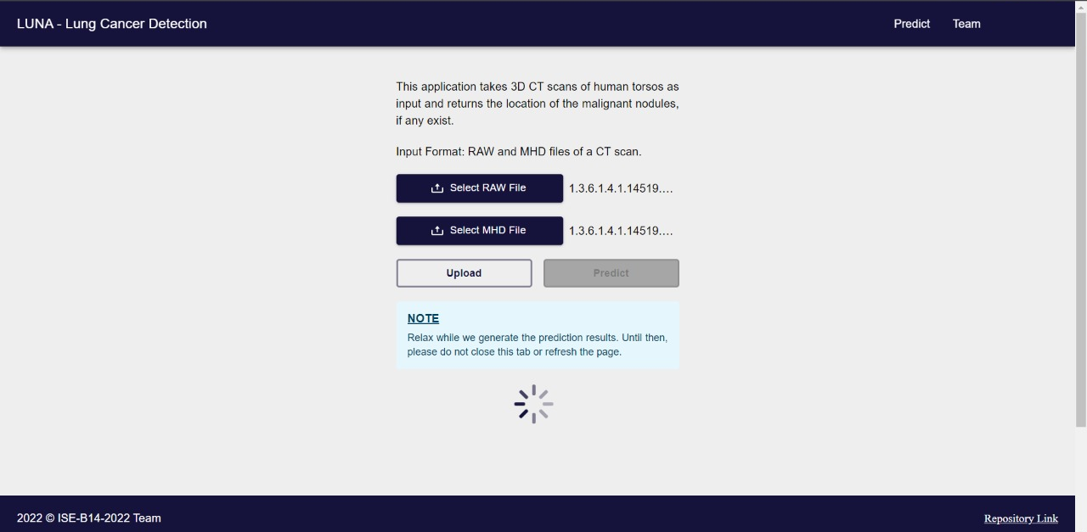
RESULTS AND DISCUSSIONS
WEB APP

Slide 33
PAPER PUBLISHED DETAILS
National_Conference_Paper__B14.pdf

Slide 34
CONCLUSIONS AND FUTURE ENHANCEMENT
In this project, an automated lung cancer detection system procedure was implemented based on the image processing on the 3D CT scans of the lung.
This system can help answer questions about the classification of cancer as benign or malignant.
The overall system aims to build a working, end-to-end system that attempts to diagnose lung cancer from CT scans and achieved good results on the cancer classification task with a 99.7 % accuracy.
There is a distinction to be made between a fully automated system and one designed to supplement a human's talents. Once a piece of data is identified as irrelevant by the automated system, it is lost forever. However, when presenting data to a person, they should be allowed to peel back some of the layers and examine the near misses, as well as interpret the system’s conclusions with confidence.

Slide 35
REFERENCES
3D Neural Network for lung cancer risk prediction on CT volumes 2020, Daniel Korat.
Lung Cancer Detection Based On CT-Scan Images With Detection Features Using Gray Level Co Occurrence Matrix (GLCM) and Support Vector Machine (SVM) Methods 2020, Qurina Firdaus, Riyanto Sigit, Tri Harsono, Anwar Anwar.
Automated Detection of Lung Cancer Using CT Scan Images 2020, Ariful Hoque, A.K.M. Ashek Farabi.
An Automatic Lung Cancer Detection and Classification (ALCDC) System Using Convolutional Neural Network 2020, Wadood Abdulg, 13th International Conference on Developments in eSystems Engineering (DeSE)
Malignant Lung Nodule Detection using Deep Learning, 2020, Amrit Sreekumar, Karthika Rajan Nair, Sneha Sudheer, Ganesh Nayar H and Jyothisha J Nair, International Conference on Communication and Signal Processing, July 2020
Lung Cancer Detection using Co-learning from Chest CT Images and Clinical Demographics 2019, Jiachen Wang, Riqiang Gao, Yuankai Huo, Shunxing Bao, Yunxi Xiong, Sanja L. Antic, Travis J. Osterman, Pierre P. Massion, Bennett A. Landmana.
Detection of Lung Cancer using CT Scan Images, 2019, Nidhi S. Nadkarni, Sangam Borkar, the Third International Conference on Trends in Electronics and Informatics (ICOEI 2019)
Diagnostic classification of lung nodules using 3D Neural Networks 2018, Raunak Dey, Zhongjie Lu, and Yi Hong.
Recurrent Residual Convolutional Neural Network based on U-Net (R2U- Net) for Medical Image Segmentation, Md Zahangir , Mahmudul Hasan, Chris Yakopci.

Slide 36
Question and Answer

Slide 37
THANK YOU

